Slide 1
What is a hacker?
? ? ! !

Slide 2
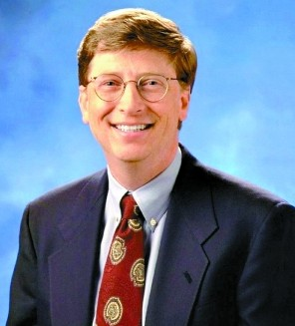
Bill Gates

Slide 3
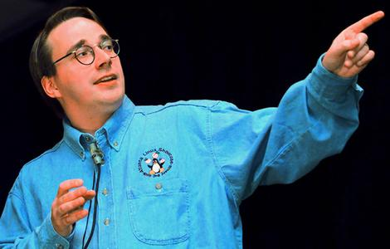
Linus Torvalds

Slide 4
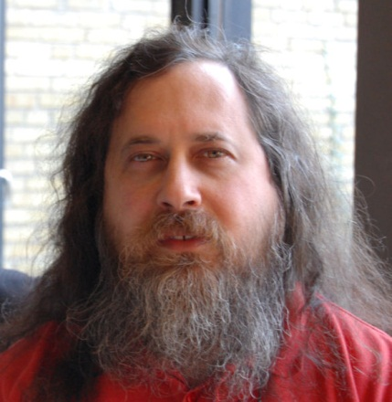
Richard Matthew Stallman

Slide 5
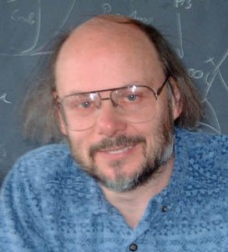
Bjarne Stroustrup

Slide 6
Who?
Who is a hacker?

